Slide 1

Rainfall prediction
in Australia
Created by:
Sahil Sigroha

Slide 2

Acknowledgement
We would like to express our special thanks and gratitude to Mr. Utkarsh Tiwary sir as well as Mr. Anil Gupta sir who gave us the golden opportunity to do this wonderful project on the topic Rainfall Prediction in Australia, which also helped us in doing a lot of research and we came to know about so many new things.
We are really thankful to all of them, moreover, it also helped us in increasing our knowledge and skills.

Slide 3

OBJECTIVE
A project on predicting whether it will rain tomorrow or not by using the Rainfall in Australia dataset.
This project is tested over lot of ML models like catboost, logistic regression, gaussian NB, KNN, and xgboost.
Model deployed using flask after creating pickel files.

Slide 4

Implementation Algorithm
Data Collection:
[Rainfall Prediction in Australia dataset](https://www.kaggle.com/jsphyg/weather-dataset-rattle-package) from Kaggle.
Data preprocessing
Missing Values Handled by Random Sample imputation to maintain the variance.
Categorical Values like location, wind direction are handled by using Target guided encoding.
Outliers are seen using boxplot and after that clipped accordingly.
Imbalanced Dataset was handled using SMOTE.
Model Creation:
Different types of models were made like catboost, logistic regression, gaussian NB, knn, xgboost.
Out of these catboost performed well with accuracy of 0.89.
The conclusion were made using classification metrics, roc curve and auc score.
Model Deployment
First pickel file is created to dump for deployment.
The model is deployed using Flask .

Slide 5

Model Deployment Steps
First create a virtual environment by using the following command:
conda create -n myenv python=3.6
Activate the environment using the below command:
conda activate myenv
Then install all the packages by using the following command
pip install -r requirements.txt
Now for the final step. Run the app
python app.py

Slide 6
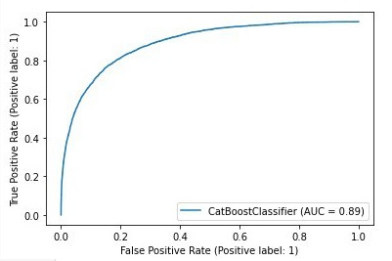
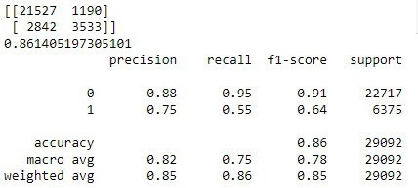
Accuracy
Out of the models performed , catboost performs very well giving an AUC and ROC score around 89 far better than others.

Slide 7
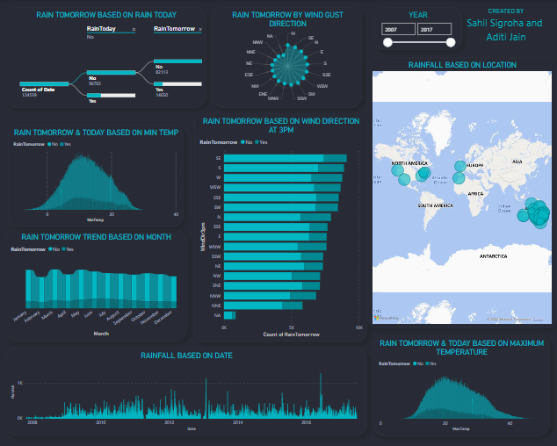
Dashboard
Decomposition tree explained by rain tomorrow based on rain today.
Radar chart showing rain depending upon the wind gust speed.
Rain tomorrow is shown in Stacked bar chart and ribbon chart based on month, wind direction min and max temperature.
Rainfall based on date is represented in clustered column chart.
Rainfall based on location is shown by map.

Slide 8


CONCLUSION
The project depicts whether in Australia the next day will be sunny day or rainy day. By adding parameters such as temperature, sunshine, humidity, pressure, wind direction, wind speed, will reflect the result shown in the background.

Slide 9
Thank You

